Slide 1
Project Plato
Zach, Mike, Jude

Slide 2
Our Team Project is great

Slide 3
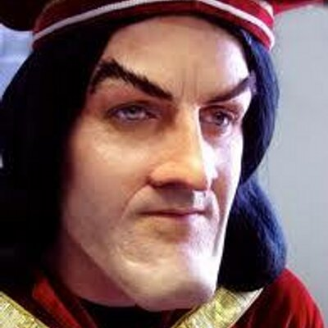
This is what our project does
It covers these problems
Yeast
Weast
Yeet
Feet
Meet
Meat
This isn’t just any shitposting…
This is advanced shitposting

